Slide 1






Slide 2





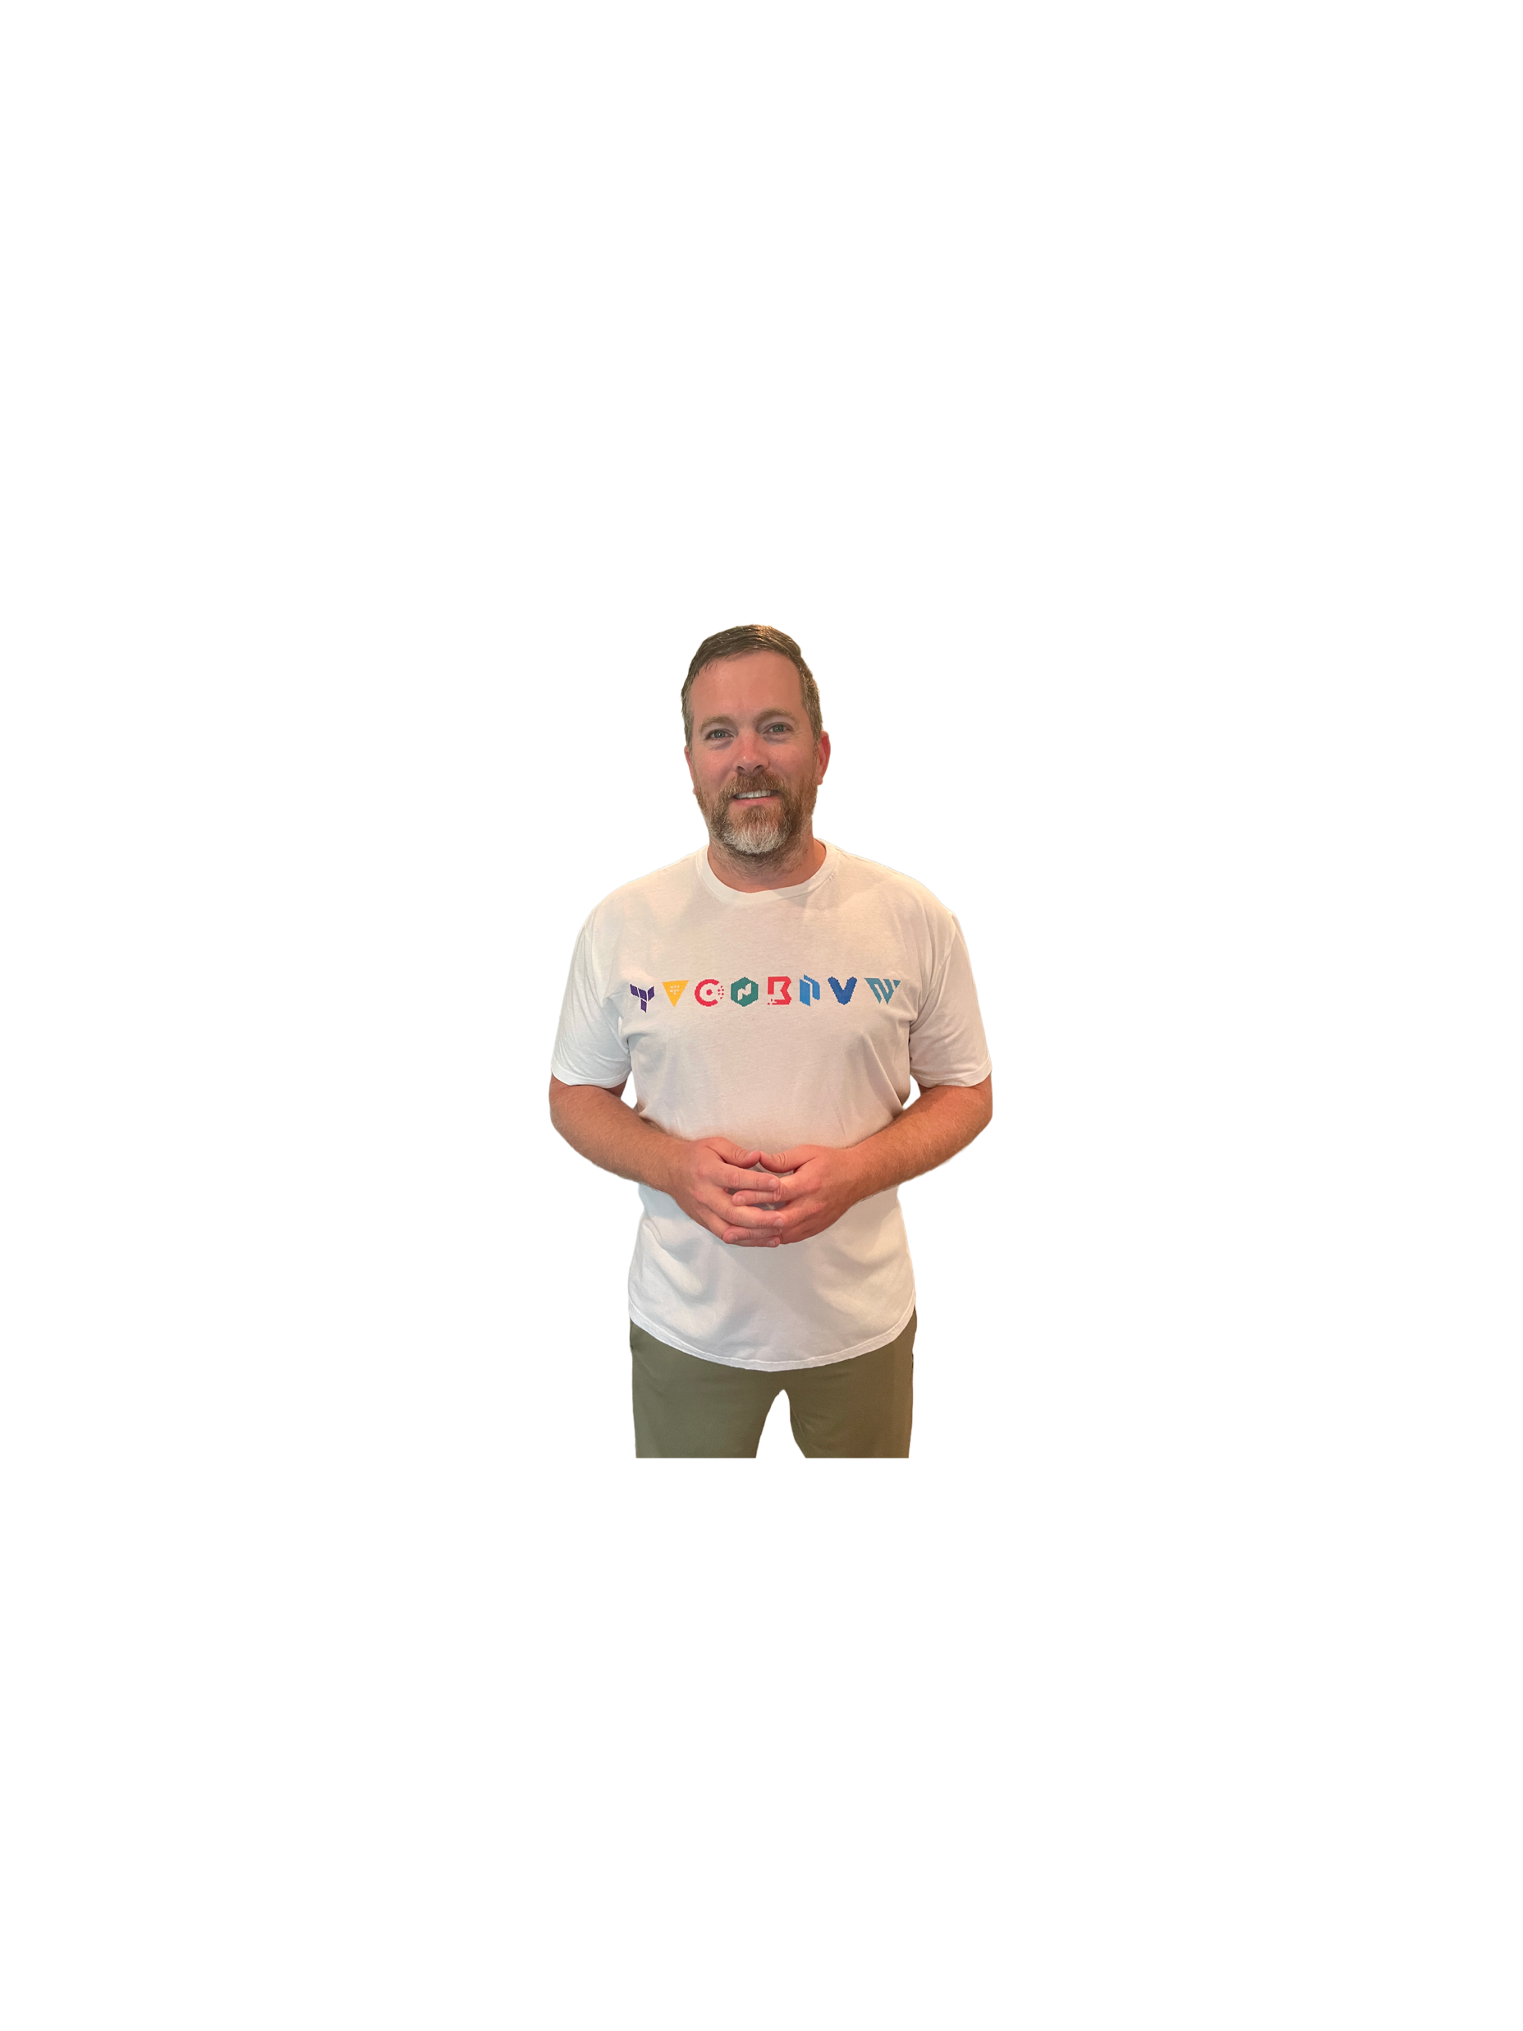




Slide 3

Building Automated Machine Images using HashiCorp Packer

Slide 4





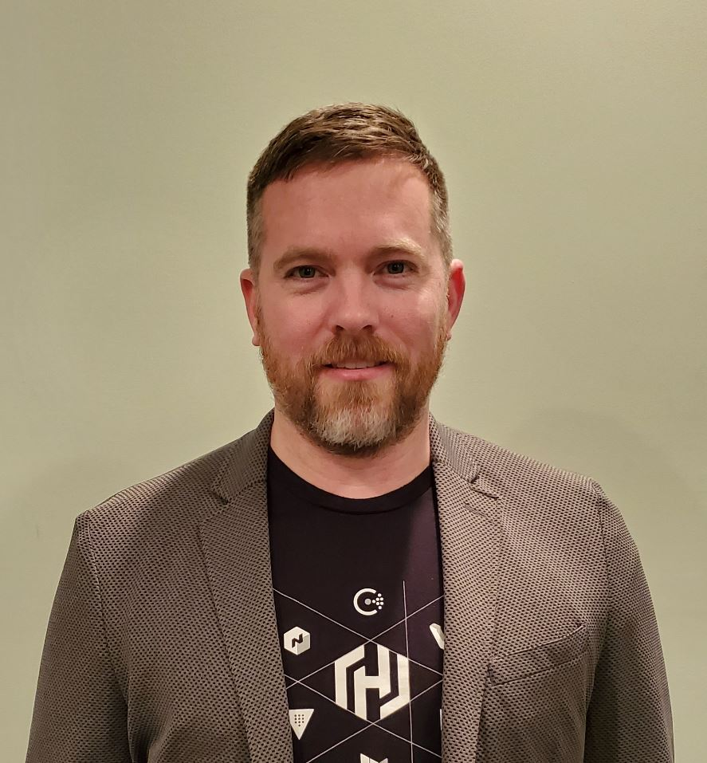
Hello!
@btkrausen
github.com/btkrausen
https://krausen.io
I am Bryan Krausen
I'm a Principal Solutions Architect specializing in HashiCorp and AWS solutions.
Currently have many courses on other HashiCorp products, such as Terraform, Vault, and Consul
*Not Affiliated with HashiCorp

Slide 5
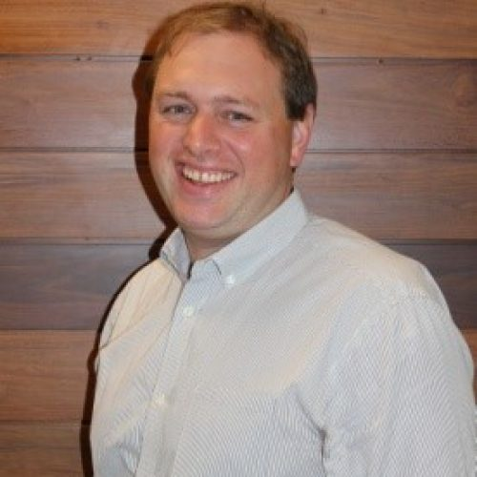
@gmaentz
Hello!
github.com/gmaentz
https://maentz.net
I am Gabe Maentz
I'm a Director of Solution Architecture specializing in HashiCorp and DevOps solutions
Experienced practitioner, life-long learner with a passion for teaching. I am a lead on many private courses on as Terraform, Vault, and GitLab.
*Not Affiliated with HashiCorp

Slide 6
Experience
Bryan and Gabe bring almost 10 years of combined experience with HashiCorp Products

Slide 7





Course Objectives
RPT
Introduce HashiCorp
Packer
Install and Operationalize
Take a Hands-On Approach to Learning Packer
Understand Various
Components
Cloud Platform and
On-Premises Integrations
Code Organization and
Versioning

Slide 8


Course Format
Provide basis for discussion and topic at hand
Make sure students understand terms and definitions
Will set the stage for Packer hands-on labs
Will attempt to be short and to the point
Lectures
Hands-on discussions using one or more Packer files
For the most part, demos will use a single cloud/platform
Multi-platform Hands-On Labs will also be included
Hands-On Labs

Slide 9




Course Content
Slides
Available in PDF in Each Section
Resources
References Links Available in Each Section
Mind Map
PDF of a Mind Map for Each Section
Lab Guides
PDF of Each Lab Demonstration

Slide 10
RPT
Writing Packer
Templates
Variables
Post-Processors
Integrations
2
4
6
8
1
3
5
7
9
Introduction to
HashiCorp
Packer
Builders
Provisioners
Code
Organization
Other Uses
For Packer
Course Agenda

Slide 11



Course Resources
RPT
github.com/btkrausen/hashicorp
Building Automated
Machine Images using
HashiCorp Packer
Send Us a Message or Use
the Udemy Q&A Feature

Slide 12


Let's Get Started

Slide 13
END OF SECTION

